Slide 1

WEATHER MONITORING USING NODEMCU
TEAM MEMBERS:
Under the Esteemed Guidance of
Ms. M. Sirisha , M.Tech
Assistant Professor, ECE Department
PULAPARTHI RAMYANJANI(19PA1A04D8)
SHAIK KHAJA MASTAN AHMED(19PA1A04E9)
SIRIGINEEDI SRI SIDDI SAI(19PA1A04F0)
NUTHALAPATI ANIL(19PA1A04C1)
LIKHITHAPUDI MAMATHA RANI(20PA5A0420)
Department of Electronics and Communication Engineering
VISHNU INSTITUTE OF TECHNOLOGY(A), BHIMAVARAM
(Approved by AICTE, Permanently affiliated to JNTUK, Accredited by NBA & NAAC)
22nd September,2021

Slide 2
CONTENTS:
Introduction
Components Required
Circuit diagram
Schematic Diagram
Working
Results of hardware
Conclusion
References

Slide 3
INTRODUCTION:
This project is mainly based on three sensors. that is the rain sensor, DHT-11 and LDR sensor.
Through this, we can see factors such as rainfall. temperature, humidity, and amount of light.
The specialty is that we can monitor all this over the internet through the blink app.
So, it is clear that this project is a creation of loT technology.
We had done this project at a low cost and is use it for farms and greenhouses…

Slide 4
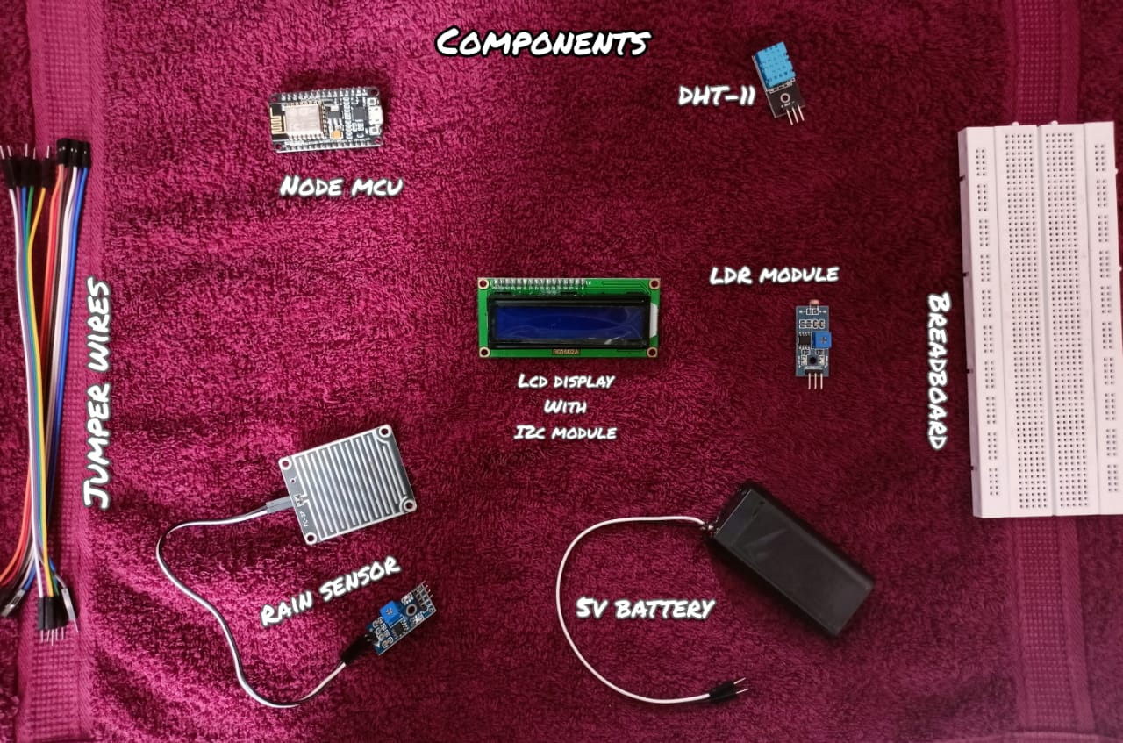

Slide 5
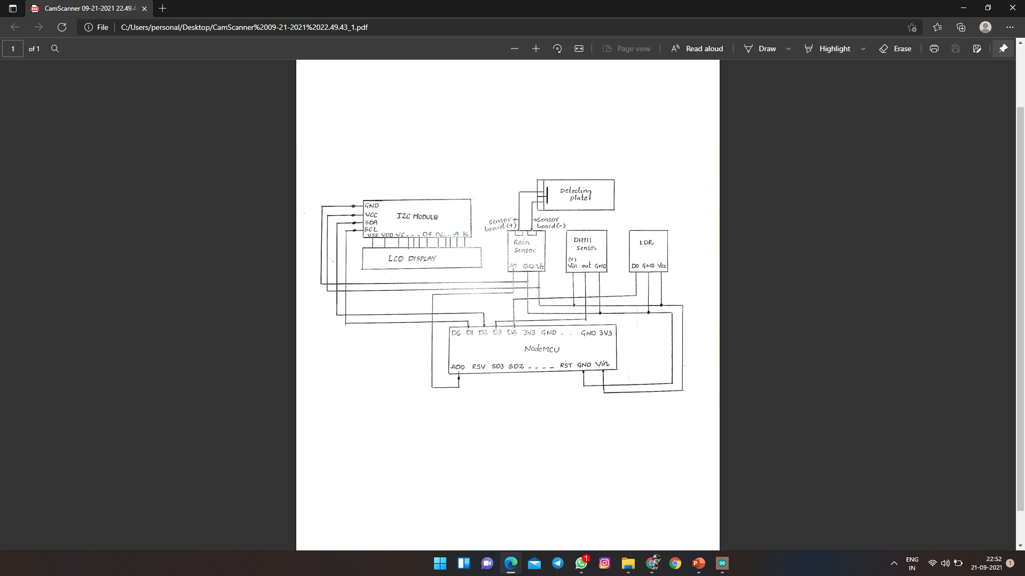
CIRCUIT DIAGRAM:

Slide 6
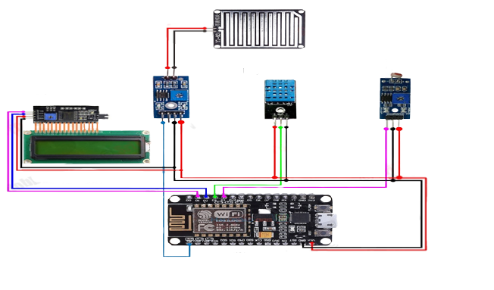
SCHEMATIC DIAGRAM:

Slide 7
WORKING:
First sensor collects the data of their respectively such as DHT11 sensor which collects the data of temperature and humidity.
LDR sensor which collects the data of light intensity of surroundings.
Rain level sensor which collects the data of Rain level .
Now all this data will be sent to Nodemcu. It will process data and sends to Lcd display and through wifi, updates the data in blynk app.

Slide 8
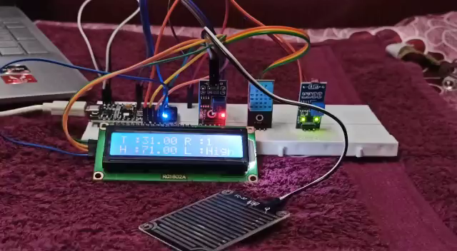
RESULTS OF HARDWARE

Slide 9
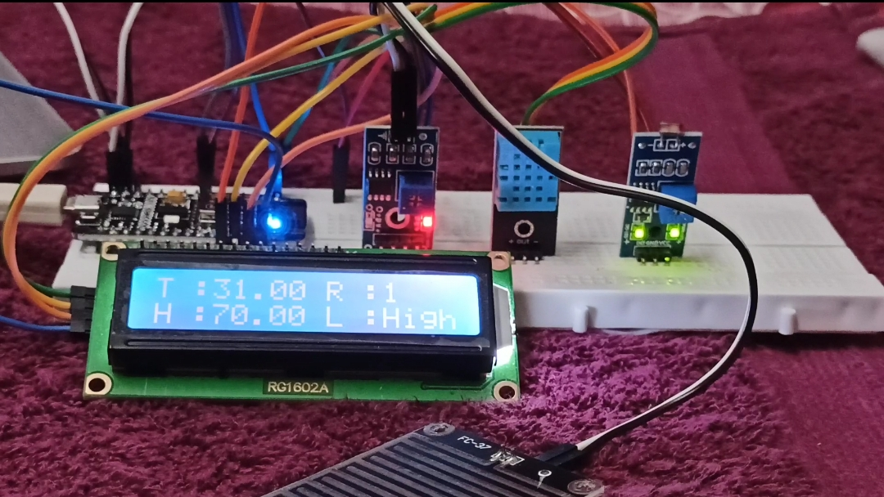
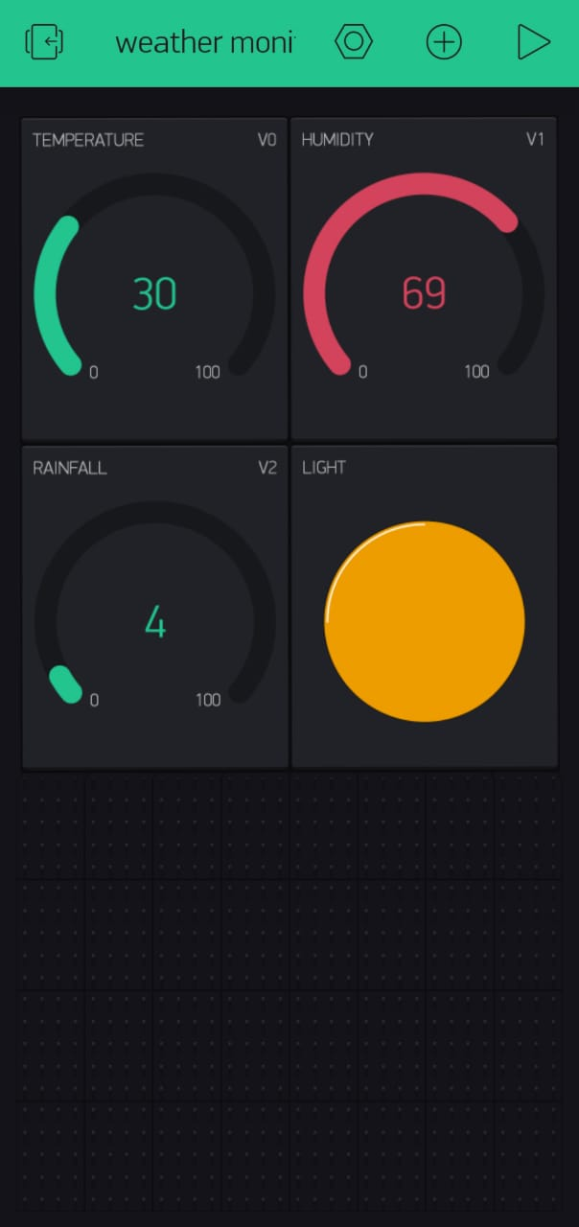
RESULTS OF HARDWARE:

Slide 10
CONCLUSION:
By the completion of project, we have fulfilled the objective of monitoring the climate around us and we made a cost-effective weather monitoring system which has many applications.
We made the project with the best of our abilities in it and this project has very future scope.
We can further enhance with many abilities like adding an ai system which can predict the future weather and other things, or we can add an alarm which can help us warn us in case of any danger.
Due to this we enhanced our mechanical knowledge along with electronics & software portion.
To be more precise, the completion of the project has raised our confidence to a next level, where we feel more confident about our abilities as an engineer.
Hence, we concluded that, this project perceived a lot of experience and knowledge in the field of automation.

Slide 11
REFERENCES:
[1] Dhanalaxmi, B., & Naidu, G. A. (2017, February). A survey on design and analysis of robust IoT architecture. In 2017 International Conference on Innovative Mechanisms for Industry Applications (ICIMIA) (pp. 375-378). IEEE.
[2] Krishnamurthi, K., Thapa, S., Kothari, L., & Prakash, A. (2015). Arduino based weather monitoring system. International Journal of Engineering Research and General Science, 3(2), 452-458.
[3] Sabharwal, N., Kumar, R., Thakur, A., & Sharma, J. (2014). A Low-Cost Zigbee Basedautomatic Wireless Weather Station With Gui And Web Hosting Facility. International Journal of Electrical and Electronics Engineering.
[4] Mahmood, S. N., & Hasan, F. F. (2017). Design of weather monitoring system using Arduino based database implementation. Journal of Multidisciplinary Engineering Science and Technology (JMEST),4(4),7109

Slide 12
Source Code:
https://github.com/19pa1a04e9/miniproject/
Video Link:
https://drive.google.com/file/d/1QyOg4bCUID3DWSitZXWE7ZVezXfFKmt-/view?usp=drivesdk

Slide 13
THANK YOU!!

